Slide 1
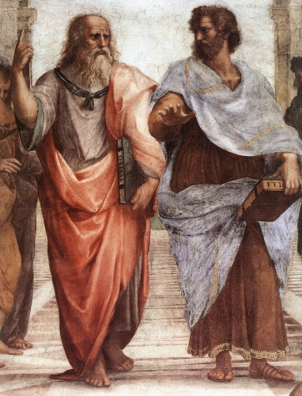
Aristotle’s Ethics
Virtue Ethics

Slide 2
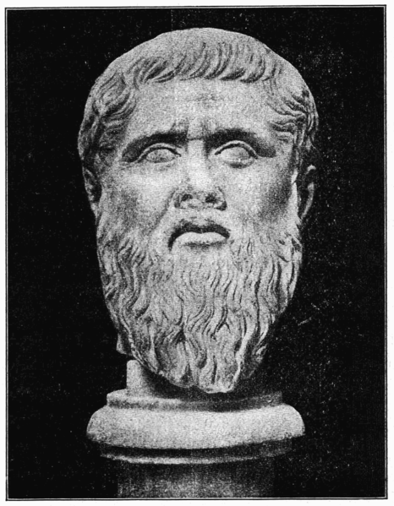
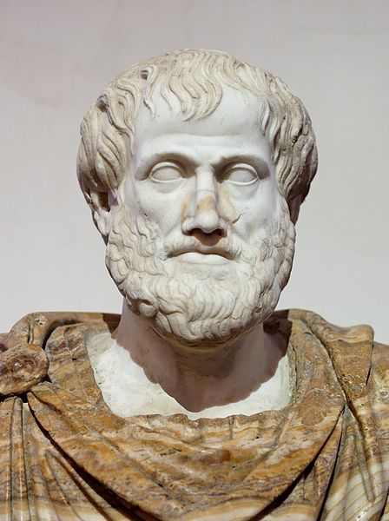
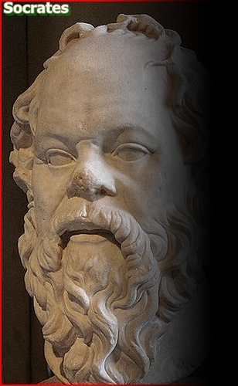
Greek Philosophers (500BC – 200BC) Timeline
The Great Three
Plato, 20, meets Socrates, 60
Aristotle, 17, meets Plato, 62
Plato (429 - 347)
500 BC
200 BC
Socrates (469 - 399)
Aristotle (384 - 322)

Slide 3
A Roman copy of a bust of Aristotle by the Greek master, Lysippos in 330 BCE
http://commons.wikimedia.org/wiki/File:Aristotle_Altemps_Inv8575.jpg

Slide 4
Aristotle’s Ethics
The Nichomachean Ethics is a collection of Aristotle’s notes, apparently edited by his son, Nichomachus.
The work is famous for being accessible, if not well organized.
Modern ethics is focused on rights and duties
Aristotle is interested in them too (indirectly), but he is more interested in
what is good for humans, and
how we ought to live

Slide 5
Foundational Experience
Aristotle does not provide any arguments to show that courage, temperance, generosity, etc., are good.
He does, however, assert early in NE (1095b4-6) that one must have experience of good to comprehend ethics:
For example, someone raised in a meth house will have so little experience of the subject matter that arguments about the goodness of a virtue will be unintelligible.

Slide 6
Some Goods Better than Others
Aristotle begins the NE considering all the disagreement among us about what is best of all the goods: pleasure, honor, love, wealth, fame, glory, etc.
He uses a distinction between instrumental and intrinsic goods to find the best, highest good.

Slide 7
Instrumental and Intrinsic Good
Instrumental good =df something good as a means to something else
Having a tan? Good for getting a date
Having a date? Good for falling in love
Being in love? Good for its own sake (intrinsically), and for happiness (as a means to happiness)
Being happy? Good for its own sake, and as a means to …

Slide 8
The Highest Good
NOTHING.
It seems that happiness is not desired for anything other than itself. It is intrinsically desirable but not instrumentally so.
Is that true of anything else? Try out …
Honor? Good for its own sake, but also as a means to happiness.
Fame? Good for its own sake, but also as a means to happiness.
Happiness, then, seems to be the highest good for humans.
We desire it for its own sake, but never, seemingly, for anything else.
It seems self-sufficient.

Slide 9
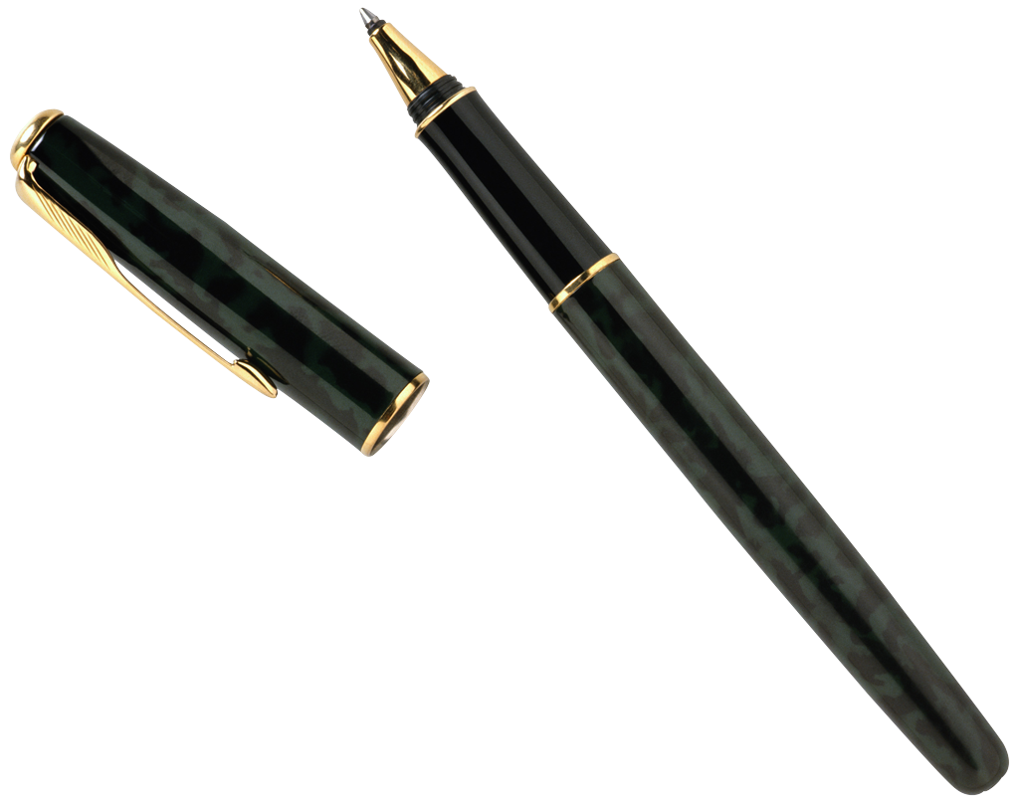
Human Nature
The Instrumental/Intrinsic good distinction leads us to conclude the good for humans is happiness. There is, however, another method for identifying the good of something that Aristotle employs …
He says that the good of a thing is its unique function:
the good of the eye is seeing, and it’s a good eye if it sees well
the good of a pen is writing, and it’s a good pen if it writes well
Aristotle then asks, what is the good of human beings?
the good of a human is reason, and it’s a good human if it reasons well.
Humans are rational animals (common definition of humans in ancient Greece).

Slide 10
Definition of Happiness
We have seen that
THE GOOD is happiness (most desired), and
THE GOOD is reasoning well (by analogical argument)
Aristotle produces his definition of happiness from those 2 lines of reasoning (since happiness and reasoning well must be the same somehow):
HAPPINESS = REASONING WELL
… or, in Aristotle’s own words:
HAPPINESS =df an activity of the soul (reasoning) in conformity with virtue (reasoning well)
so,
happiness is NOT a feeling
happiness is NOT a condition or state of mind
happiness is NOT desire-satisfaction (getting what you want)
happiness is NOT something you can receive

Slide 11
Virtue → Happiness
In Book I, Chapter 13 of the Nichomachean Ethics, Aristotle says:
Since happiness is an activity of the soul in accordance with perfect virtue, we must consider the nature of virtue; for perhaps we shall thus see better the nature of happiness.
So, let’s look! …

Slide 12
Virtue
Aristotle: to understand happiness, we must understand virtue…
Doing something well or with excellence is one definition of a virtue.
Things are said to have virtue when they perform the function proper to them well … the function that is proper to a thing is called it’s “work
Screwdrivers drive screws; that is their work, or, loosely speaking, their virtue
Also, a thing’s “work” is what only it can do, or what nothing else can do so well (Plato, Republic, 352-3)

Slide 13
Intellectual Virtues
For Humans this “work” is reason (we are rational animals), composed of
theoretical wisdom (sophia)
scientific reasoning (episteme, gk; scientia, latin), and
intuitive understanding (nous)
practical wisdom/practical reason, prudence (phronesis)
craft knowledge, skill, art (techne)
Note that, though tradition calls these kinds of reasoning ‘virtues’ they are not virtues, strictly speaking (except for the first & fourth). Can you see why?
All 5 are intellectual virtues, NOT moral virtues

Slide 14
Moral Virtues (And One Intellectual Virtue)
Aristotle identifies 11 moral virtues, all governed by one intellectual virtue, prudence—good deliberation
Courage
Temperance
Generosity
Magnificence (generosity with wealth)
Magnanimity (proper pride)
Right ambition
Good temper
Friendliness
Truthfulness
Wit
Justice
All except Justice are a “mean” between extremes

Slide 15
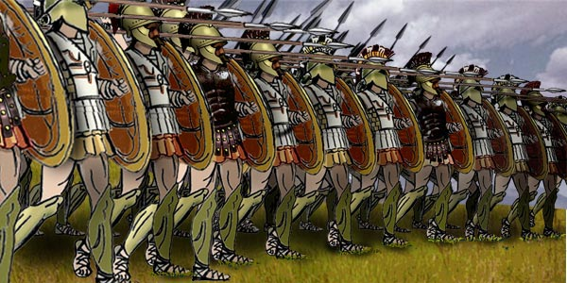
Anatomy of a Moral Virtue
Cowardliness -------- Courage ---Rashness
Courage is the mean between being a coward and being rash.
A popular example:
When running into battle, the coward lags behind, and the brash or rash person runs ahead. The courageous person keeps with his or her mates.
Notice that ‘courage’ above, is not in the middle between the extremes. That is because prudence, the intellectual virtue that finds the mean, tells us that being courageous is more like being rash than it is like being cowardly. In fact, all the virtues depend on prudence for their existence … we couldn’t discover the moral virtues without skillful deliberation.
For an example of prudence determining the mean, see Book 3, chapters 6 and 8 (check this link or google for it): http://www.constitution.org/ari/ethic_03.htm

Slide 16
For Moral Virtue, Reason Must Rule
If a person is courageous or temperate by nature they have moral virtue, but not in a strict sense; being morally virtuous requires submitting one’s feelings and actions to reason:
as situations change or more information arrives, understanding changes and reason adjusts the actions (hollering at your kids, say, becomes coaxing, or vice versa) and passions (anger, say, becomes consternation, or vice versa)

Slide 17
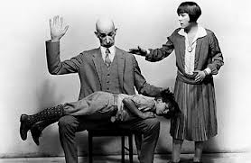
How are Moral Virtues Acquired?
Virtues are attained or acquired by practice and habit
We become just by doing just acts, generous by generous acts, temperate by temperate acts, etc.
So, if virtues are attained by practice and habit (we must do just acts to become just, and friendly acts to become friendly, etc.), how do we know what acts are just or friendly in the first place?
We learn by observation (look back to slide 3)
We ask a virtuous person
We use prudence to find the mean, or
the right amount of an action,
the right time for an action,
the right object (immediate and or distant object) for an action,
the right manner of acting, etc.

Slide 18
Dispositions, not Habits
Moral virtues are not habits; they are:
dispositions to act that are acquired by habituation.
purposive dispositions, lying in a mean determined by reason
To posses a virtue is
to hold a complex mental framework of the right feelings, attitudes, understanding, insight, experience, etc. …
to have a multi-track disposition, unlike a simple habit such as being a tea drinker or coffee drinker.
For more on multi-track dispositions, see Rosalind Hursthouse on Virtue Ethics: http://plato.stanford.edu/entries/ethics-virtue/

Slide 19
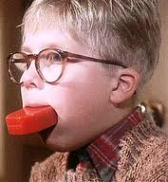
Multi-Track Dispositions
Take truthfulness: A truthful person …
tells the truth (but not indiscreetly)
raises kids to do so
encourages other to do so
doesn’t find jokes about dishonesty funny
is surprised and saddened by dishonesty in friends
doesn’t provide the truth to those intending to misuse it
cares about truth for its own sake (values it above personal feelings, say)
Etcetera

Slide 20
To Sum Up Moral Virtue
A morally virtuous person, then, ideally,
Has all eleven moral virtues
Each virtue is established by practice and habit, subjecting feelings and actions to reason
Each virtue is settled between excess and deficiency by comprehensive understanding, or multi-track assessment
For the value of virtue, see Alasdair MacIntyre’s Chess example here:
https://www.iep.utm.edu/mac-over/

Slide 21
Getting and Keeping Moral Virtues
Possessing the virtues is a matter of degree, and few if any possess them all or equally.
Since a virtue is a multi-track disposition to do what is right—a disposition that “goes all the way down”—we only find it hard to do what is right when our disposition does not go all the way down.
If we do what is right due to a disposition established by practice and habit, Aristotle calls our condition virtuous.
If we do what is right despite contrary inclination, Aristotle calls our condition continent, something inferior to virtuous.
If we try but fail to do what we know we should, we are called incontinent.
If we have no interest even in trying to do what we know we should, we are called vicious.

Slide 22
Virtue or Continence is Best?
We ordinarily praise folks for overcoming their desires or temptations in order to do what is right. Don’t continent people deserve praise then, perhaps even more than the virtuous?
Perhaps, according to Hursthouse (slide 17), depending on what makes doing what is right hard:
Giving back a lost wallet full of money is easy for a virtuous person
If it is hard because you are in dire need of money, then returning it is praiseworthy
But, if it is hard because you don’t care about other people, its return is less praiseworthy
Is this right?

Slide 23
Moral Virtue
Virtues make their possessor good, but what do we make of courage in, say, a thief?
Recall that some virtues we might have by nature, but unless they are multi-track, and settled by comprehensive understanding, they aren’t virtues strictly speaking.
Does a thief overcome the correct fears for the right reasons? If not, the thief only has something like the virtue of courage.

Slide 24
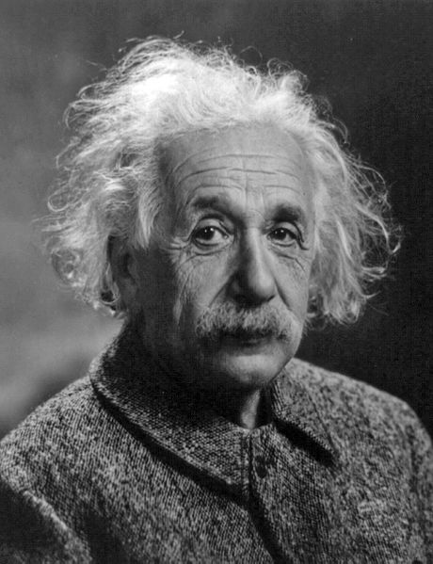
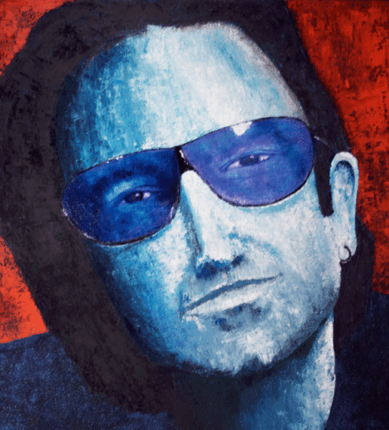
Back to Happiness…
If happiness is “an activity of the soul in conformity with virtue,” what virtue is meant, intellectual virtue, or moral virtue?
Aristotle’s answer is “both,” but in Book X he says
since happiness is virtuous activity, it’s only natural that it be in conformity with the highest virtue
the highest virtue (theoretical wisdom) is intellectual,
and so
happiness is primarily intellectual activity
secondarily moral activity
Notice, the title of chapter 8, Book X: Moral Activity is Secondary Happiness
Question: So, who is happier …
Einstein or Bono? _____

Slide 25
Happiness, Again
Why is theoretical reason highest?
It has little in common with animal nature
It is more god-like
Practical reason exists for its sake
What is so great about the life of contemplation?
Its pleasure is enduring (we can enjoy its constant, mild pleasure continuously)
Its pleasure is certain (if concepts provide your enjoyment, no one can take your toys away)
The last points, Aristotle says, agree with the common view that true happiness is a stable, enduring quality

Slide 26
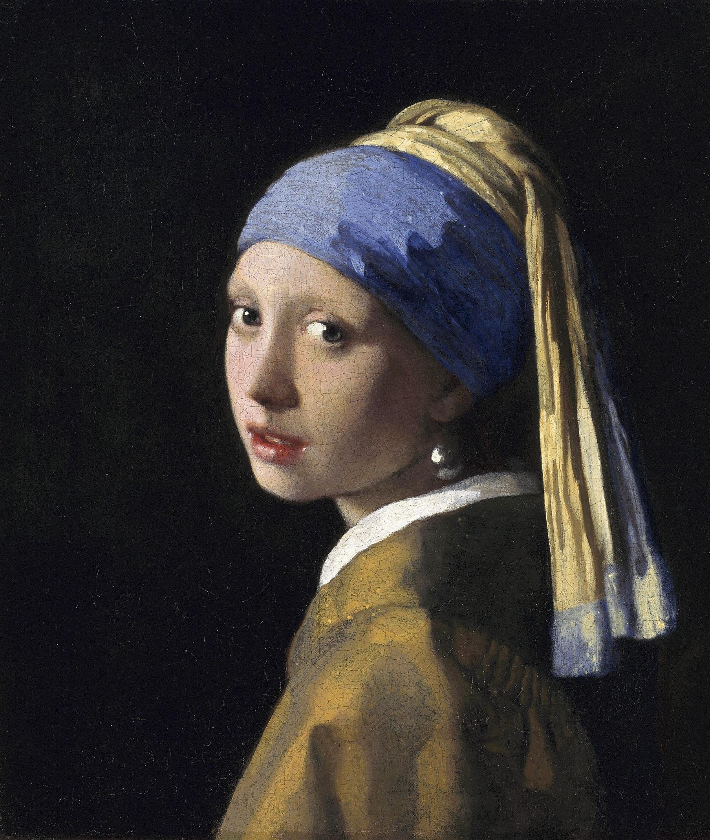
Why Be Moral?
Joe Sachs, writing for the Internet Encyclopedia of Philosophy:
The word the translators are afraid of is to kalon, the beautiful. Aristotle singles out as the distinguishing mark of courage, for example, that it is always “for the sake of the beautiful, for this is the end of virtue” … Of magnificence, or large-scale philanthropy, he says it is “for the sake of the beautiful, for this is common to the virtues.”
And he [Aristotle] explicitly compares the well made work of art to an act that springs from moral virtue.… An action is right in the same way a painting might get everything just right. – Joe Sachs

Slide 27
References
Richard Kraut at Northwestern, Evanston, IL:
http://plato.stanford.edu/entries/aristotle-ethics/
Rosalind Hursthouse at Auckland, New Zealand:
http://commons.wikimedia.org/wiki/File:RHursthouse.jpg
Socrates’ image:
http://s3.amazonaws.com/everystockphoto/fspid30/21/66/25/5/history-2166255-o.jpg
Plato’s and Aristotle’s images:
http://s3.amazonaws.com/estock/fspid10/25/86/21/0/raphael-plato-aristotle-2586210-o.jpg
http://creativecommons.org/licenses/by/2.5/
http://commons.wikimedia.org/wiki/File:Aristotle_Altemps_Inv8575.jp
http://commons.wikimedia.org/wiki/File:D369-platon.-L2-Ch8.png
Einstein’s Image: http://commons.wikimedia.org/wiki/File:Albert_Einstein_Head.jpg
Bono’s Image:
http://commons.wikimedia.org/wiki/File:Bono_-_60x60_Mixed_Media_on_Canvas_by_Fine_Artist_Rene_Romero_Schuler.gif
Slide 26 image
http://commons.wikimedia.org/wiki/File:Weed_Burner,_Sitting_on_a_Wheelbarrow_with_his_Wife.jpg

