Slide 1
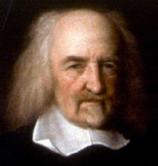
Thomas Hobbes Leviathan
Social Contract Theory

Slide 2
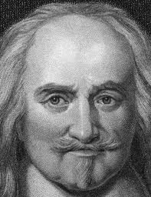
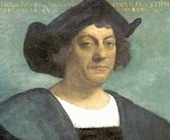
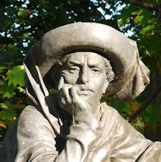
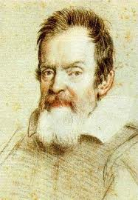
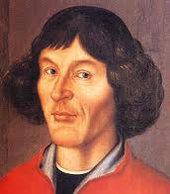
Age of Discovery
(1415-1700)
England
Shakespeare
(1564-1616)
Hobbes (1588-1679)
1400
Columbus (1451-1506)
1700
1651 Publishes Leviathan
Prince Henry the Navigator (1394-1460)
Spain
Portugal
Copernicus (1473-1543)
Galileo (1564-1642)
Prussia
Italy

Slide 3
Thomas Hobbes
Thomas Hobbes (1588-1679) developed the social contract theory of political institutions, employing commitment to some form of psychological egoism.
Hobbes rejected medieval scholastic philosophy, preferring the new, modern, scientific ways of thinking on the rise in England and Europe.
-from Wikipedia.org

Slide 4
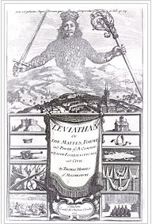
Leviathan
Hobbes’s major work is titled:
Leviathan
Or
The Matter, Forme, and Power of A Commonwealth Ecclesiasticall and Civil
Right is the frontispiece of the book, as it was published in 1651

Slide 5
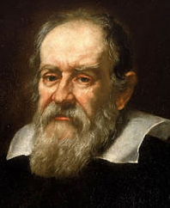
Human Nature
Hobbes views human beings as complex machines, material objects, and, in the beginning of Leviathan, gives mechanistic descriptions of the operations of our minds—emotions and reasoning.
Met Galileo in 1636; was impressed by physics and the new role science was playing in intellectual life.
‘Liberty’ is defined as freedom to do as one wishes, but one’s wishes are determined by mechanistic laws governing matter in motion. How Hobbes retains his belief in God became a problem for him politically; he was exiled from England for his views occasionally and feared for his life regularly for heresy.
Galileo 1564-1642

Slide 6
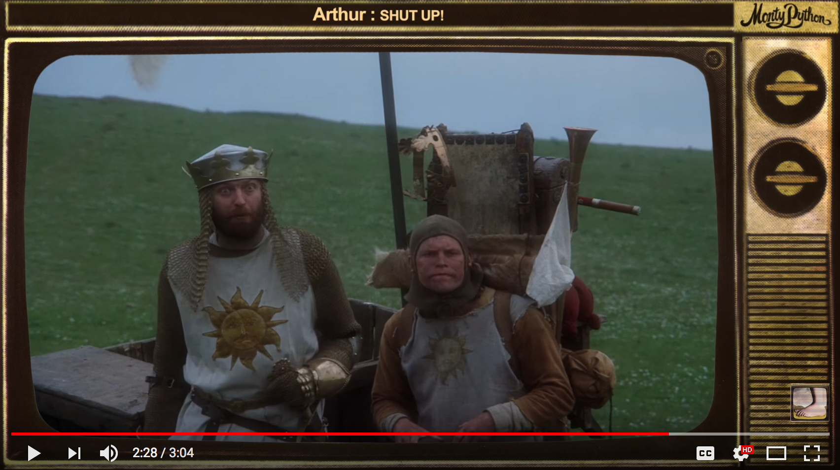
Hobbes Tries to Modernize Ethics
Hobbes wants us to consider the relations that emerge among human beings in light of our common human nature, prior to there being any society or government imposing rules upon us. In doing this, he hopes to show
why we need government
the character that government must have
what our duties are to our government
In doing this, Hobbes is rejecting the Great Chain of Being, and with it, the Divine Right of Kings, as the rational basis for governmental authority.
Might this clip from Monty Python’s, ‘Dennis the Constitutional Peasant’, contain extra credit material ???

Slide 7
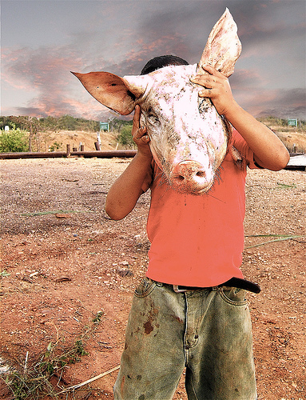
Equality
Apart from any government, nature has made us equal, according to Hobbes, in the sense that even the weakest among us can, by forming associations or devious planning, kill the strongest.
Anyone, or any group, can move into another’s place and take their property, products, life, or liberty. And those who might do this can expect the same might be done to them.
What book is this from?

Slide 8
Equality
Hobbes notes that this equality fosters quarrels due to:
Competition for goods (each having hope of overpowering the other), making people enemies.
Diffidence or lack-of-confidence leading to defensiveness, and
Glory as everyone likes to think highly of themselves, and being equal, each thinks their own honor worth fighting for
Competition makes an individual or group invade another’s domain for gain
Diffidence encourages invasion for safety
Glory encourages invasion for reputation
What Iraq War arguments correspond to these causes?

Slide 9
The Condition of War (State of Nature)
The equality among us, combined with scarce goods, yields conflict. Hobbes calls that condition ‘war’, and tells us:
“war consists not in battle only or the act of fighting, but in a tract of time wherein the will to battle is sufficiently known”
As by analogy,
“foul weather lies not in a shower or two of rain but in an inclination thereto of many days together”

Slide 10
The Condition of War (State of Nature)
Hobbes:
“ … so the nature of war consists not in actual fighting but in the known disposition thereto during all the time there is no assurance to the contrary. All other time is ‘peace’.”
Also,
“ … such a war is of every man against every man.”
Why “every man against every man,” rather than, say, group vs. group?

Slide 11
The Condition of War (State of Nature)
Finally, Hobbes most famous paragraph regarding the State of Nature:
In such condition there is no place for industry, because the fruit thereof is uncertain, and consequently no culture of the earth, no navigation nor use of commodities that may be imported by sea, … no knowledge of the face of the earth; no account of time, no arts, no letters, no society, and which is worst of all, continual fear and danger of violent death, and the life of man solitary, poor, nasty, brutish, and short.

Slide 12
The Condition of War (State of Nature)
In Chapter XIII, paragraph 10, Hobbes tells us that even if you don’t accept this conclusion about our natural state apart from government, proven by his mechanistic discussion of human passions (about attraction and aversion being basic motivators, and all our actions being reducible to those operations), ask yourself why we
lock our doors at night
lock up our belongings even from our own children
carry arms in public when transporting money
etc.
Consider Plato’s ‘Ring of Gyges’ story

Slide 13
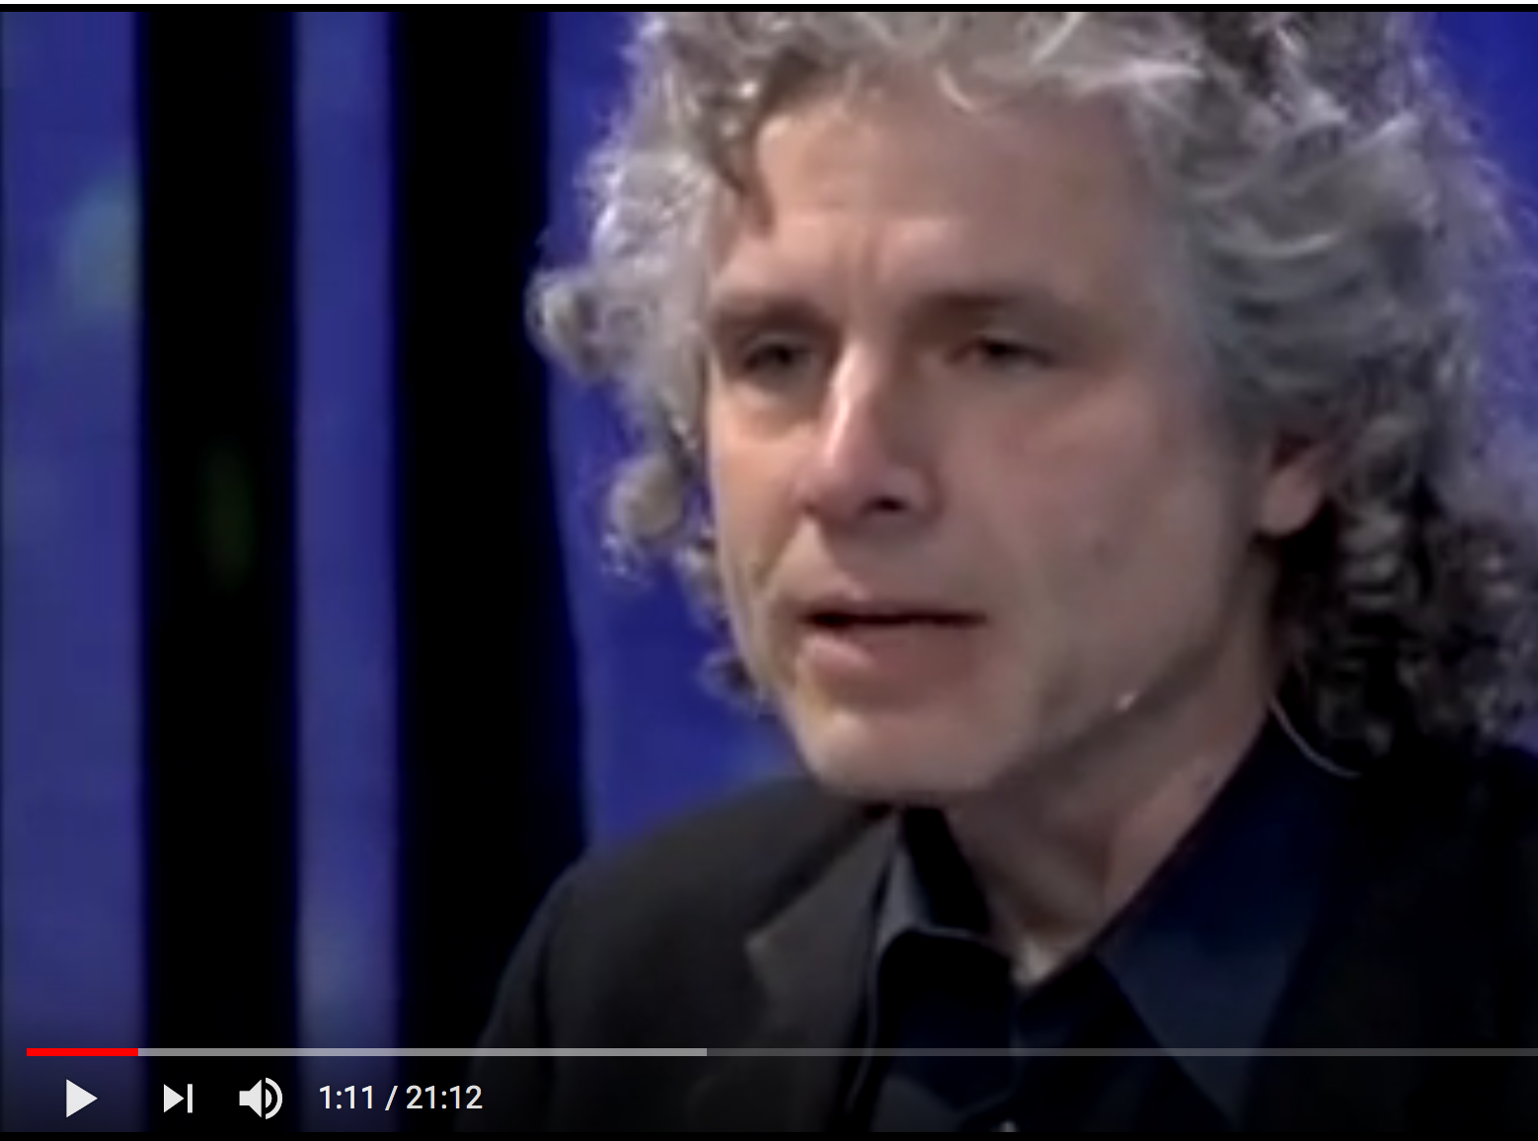
The Condition of War (State of Nature)
In Chapter XIII paragraph 11, he argues against those who think there was never a time where humans lived without government, citing “savage people in many parts of America.”
So Hobbes uses three lines of reasoning to show that humans without government live lives that are “nasty, brutish, and short.”
From the passions
From our defensive behavior even in society
From example using America
Hobbes knew America?
“In 1639, the very same year that America’s first college was named after its benefactor, John Harvard, a nearby tavern in Boston was designated as the official repository for mail coming in and out of the British colonies.” –Slate
Listen to Steven Pinker confirm Hobbes’ view of violence in America (Minutes 1:01 to 4:21)

Slide 14
The Condition of War (State of Nature)
In the State of Nature, Hobbes points out:
“The notions of right and wrong, justice and injustice, have there no place. Where there is no common power, there is no law; where no law, no injustice.”
“It is consequent also to the same condition that there be no propriety, no dominion, no ‘mine’ and ‘thine’ distinct, but only that to be every man’s that he can get, and for so long as he can keep it.”
--Ch. XIII, paragraph 13

Slide 15
Securing Peace
Mechanistic as always, Hobbes finishes his discussion of the condition of war or state of nature by citing “the passions that incline men to peace”:
Fear of death
Desire of such things as are necessary to commodious living
Hope by their industry to obtain them
These passions lead us to adopt, Hobbes hopes, his Laws of Nature.

Slide 16
Right of Nature, Laws of Nature
In the State of Nature, life is governed by what Hobbes calls ‘The Right of Nature’.
The Right of Nature: the freedom of everyone to do anything and everything that will, in their own judgment, preserve their own life.

Slide 17
Right of Nature, Laws of Nature
In the State of Nature, the Right of Nature provides everyone the right to everything
“even to one another’s body.”
“… as long as this natural right of man to everything endures, there can be no security to any man …”
Wait … what?

Slide 18
Right of Nature, Laws of Nature
Hobbes says that a ‘Law of Nature’ is
“a precept or general rule … by which man is forbidden to do that which is destructive of his life or takes away the means of preserving same, and to omit that by which he thinks it may best be preserved.”
NOTE: This, combined with the Right of Nature from the previous slide, suggests we not only are free to do anything necessary to preserve our own life, but that we have a duty to do so.

Slide 19
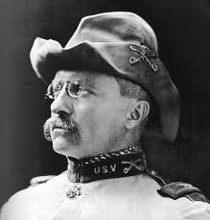
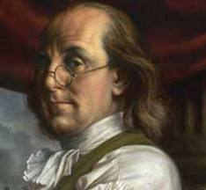
Laws of Nature
1st Law of Nature:
Branch one: Seek peace
Branch two: defend yourself, by all means
2nd Law of Nature:
Be willing to trade freedom for security
In following these laws, especially the second, we must form contracts.
He who sacrifices freedom for security deserves neither. –Ben Franklin

Slide 20
Contracts
Contracts are formed by renouncing or transferring a right (in this case, freedom to do whatever you want) in trade for some good (in this case, security, or escape from the State of Nature).
In Chapter XIV, paragraph 8, Hobbes tells us forming contracts like this is a voluntary act,
“and of the voluntary acts of every man the object is some good ‘to himself’.”
What descriptive theory of Human Nature does this sound like?

Slide 21
Contracts
One right that cannot be laid down in forming a contract is the Right of Nature. Hobbes tells us that no matter what you say, you cannot give up your right of self-defense:
“… a man cannot lay down the right of resisting them that assault him by force to take away his life, because he cannot be understood to aim thereby at any good to himself.”
What part of being a good citizen might this interfere with?

Slide 22
Laws of Nature
3rd Law of Nature:
Keep promises
From this final law, which says to stick to your agreements when you follow laws 1 and 2, arise justice and injustice. It is only once a covenant or promise is in place that we can act justly or unjustly.
But how do we trust each other to follow the 3rd Natural Law?

Slide 23
The Sovereign
We can’t.
“…covenants of mutual trust, where there is fear of not performance on either part, … are invalid.”
“… before the names just and unjust can have place, there must be some coercive power to compel men equally to the performance of their covenants, by the terror of some punishments greater than the benefit they expect by the breach of their covenant … such power there is none before the erection of a commonwealth.”

Slide 24
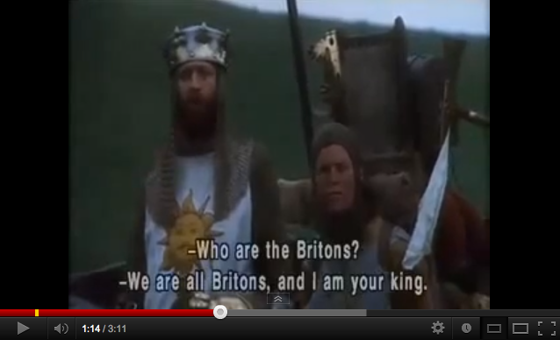
Come back, King!
Though Hobbes rejects the Divine Right of Kings as the rational basis for government, he prefers the Monarchy to the Parliament.
Long live the king!

