Slide 1
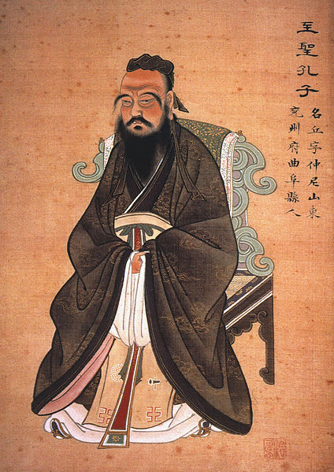
Confucianism II
Mengzi, Xunzi, and Dong Zhongshu

Slide 2
Sources
Asian Philosophies, 6th Edition, John M. Koller (hereafter “Koller”)
No Readings

Slide 3
Responses to The Warring States Period
Return to Nature
(includes Daoism)
Realism
Give up Already! (General Pessimism)
Let’s Fix This!
(Activists)
Confucianism
Mohism
Mengzi
Xunzi
Dong Zhongshu

Slide 4
Mengzi
Mengzi (372-289 BCE)
Mengzi (Mencius) was the top student of Confucius’ grandson, Zisi … founder of the Zisi School.
Came to be known as the true transmitter of Confucianism—called The Second Sage.
Gave Confucius’ moral humanism a “metaphysical foundation.” –Koller, p208 (This most likely refers to his belief in Heaven and its influence on earth)
Spent years trying to get rulers to adopt Confucianism as governmental policy, to no avail.
Believes humans are naturally (inherently, innately, and essentially … though not perfectly) good

Slide 5
Human Nature is Good Mengzi (cont.)
Whether it was Confucius’ view that the virtue, Ren (Jen in Smith), is a natural phenomenon or an acquired one is not entirely clear; he does not take up the question explicitly.
What is clear for Confucius, from Koller’s discussion, (p198), is that Ren is the virtue that makes humans human, and it is the ‘heart’ portion of a person that makes them truly human. In this way, we can say that Confucius’ answer is that Ren is natural. When he speaks of rulers or citizens who lack Ren, he means that they have not developed Ren, though, being human, they have at least a spark.
Mengzi, however, is clear about the natural / acquired question. His position is that Ren is natural. Humans are inherently good. (Koller, p212, bottom)
He provides an argument:
Everyone agrees that the sage is good by nature;
everyone shares the same human nature, therefore,
all persons are good by nature.
Convinced? ______________________

Slide 6
Side Note on “Inherence”…
On p210 Koller relates that Gaozi (likely a contemporary of Mengzi) argued human nature was neutral between good and bad.
Koller tells us that Mengzi’s response to Gaozi’s resulting view that human nature is good in some people and bad in others—good when nourished by good rulers, bad when abused by bad rulers—is that human nature is still inherently good, but that the bad ruler “allows the inherent goodness of human nature to be destroyed.”
Note that Koller’s language (“destroyed”) suggests that humans can lose their inherent goodness … ‘inherent’ must then mean merely naturally occurring, rather than essential or ineradicable.
As in, 3 sides are essential to a triangle.

Slide 7
Side Note on “Inherence”…
Notice, though, by his own words, quoted from this Encyclopedia article, Mengzi is explicit that ‘inherent’ means essential:
Appealing to experience, he [Mengzi] says:
Supposing people see a child fall into a well – they all have a heart-mind that is shocked and sympathetic. It is not for the sake of being on good terms with the child’s parents, and it is not for the sake of winning praise for neighbors and friends, nor is it because they dislike the child’s noisy cry. (2A6)
[He] argues:
Judging by this, without a heart-mind that sympathizes one is not human; without a heart-mind aware of shame, one is not human; without a heart-mind that defers to others, one is not human; and without a heart-mind that approves and condemns, one is not human. (2A6)
So, for Mengzi, we will say basic goodness is essential for human beings.
4 Cardinal Virtues: Sympathy
Shame
Deference
Judgment

Slide 8
Human Nature is Good Mengzi (cont.)
Koller, p210,
For Mengzi, who claimed that ren was an actual beginning of goodness present in each person, the problem was to explain the presence of evil in the world. If evil is due to wrong actions, it becomes necessary to distinguish between the rightness of actions and the goodness of human nature. Despite the presence of goodness, it is possible for human beings to act in a wrong way and thus bring about evil in the world. Because this is so, it is necessary to emphasize yi, the correctness of action, in order to rid the world of evil.
So, Mengzi distinguishes between the goodness of the agent and the rightness of the agent’s actions … it is possible to be a good person but choose the wrong thing.
How is this possible? _______________________________
Read Mengzi’s 3 arguments on p211

Slide 9
How to Develop Ren
How do we develop ren?
Mengzi’s answer is to emphasize yi, right conduct. While it is true that a person whose ren is fully developed will automatically do the right things, it is not true that the person whose actions are always right has ren (other virtues are required for ren, the ultimate virtue even Confucius did not claim for himself) … Still, the best way to develop ren, according to Mengzi, is to emphasize yi.

Slide 10
Why Develop Ren?
Koller tells us, p209,
While Confucius emphasized ren, … he did not discuss the question of why one should practice these virtues in terms of the natural endowments of human nature.
Mengzi, on the other hand, does address the question:
If one accepts Mengzi’s arguments for the innate goodness of human nature and agrees with his explanation of the source of evil in the world, it follows that people should live virtuously, according to ren, yi, and li (propriety), because living virtuously develops one’s humanity, leading to harmonious social relationships and an orderly society. Furthermore, to regulate one’s actions by yi and li is to live according to the innate goodness that is basic to human nature. In brief, one should practice the Confucian way because it is the way of fulfilling human nature. –Koller, p211, bottom
Does that argument work? _____________________
Who cares for “developing one’s humanity,” “harmonious social relationships,” “an orderly society” … “fulfilling human nature”? _________________
(Does ‘innate’, above, mean ‘essential’ or ‘merely inherent’? ________________)

Slide 11
Xunzi
Xunzi (313-238 BCE)
Devoted Confucian while emphasizing Law (without becoming a full-fledged Realist or Legalist)
Views Heaven as an impersonal, natural power
59 years younger than Mengzi
Believes humans are naturally (inherently, innately, but not essentially?) bad

Slide 12
Human Nature is Bad Xunzi (cont.)
Xunzi sounds very much like Thomas Hobbes:
Xunzi argues that human beings not only lack the beginnings of the four virtues claimed by Mengzi, but they actually possess the beginnings of vice in their innate self-interestedness and in their inherent natural desire for profit and pleasure. Xunzi’s theory is that people are born selfish, with desires, some of which are ordinarily unsatisfied. When desires remain unsatisfied, people strive for their satisfaction. And when many persons are selfishly striving for the satisfaction of their conflicting desires without rules or limits, there is contention and strife, which bring about disorder and are harmful to everyone. -Koller, p212, bottom

Slide 13
Mengzi v. Xunzi
(Altruism v. Egoism in Green Slides)

Slide 14
First, experience this thought experiment…
Read a very nice summary of the Ring of Gyges
Here is the story itself.

Slide 15
Egoism
Read about Egoism at Stanford U’s website (you can ignore ‘Rational Egoism’)
Two main theses to consider regarding Egoism:
Psychological Egoism (a descriptive theory): Every human act is motivated solely by self-interest
Ethical Egoism (a prescriptive theory): Every human act ought to be directed toward self-interest

Slide 16
Altruism v. Psych. Egoism
Psychological Egoism (PE) is a premise in Thomas Hobbes’ Leviathan
Problem: How can PE (every human act is motivated solely by self-interest) be true?
Are there not altruistic people?
Mother Teresa (church)
Pam Anderson (PETA)
Angelina Jolie (love of foreign children)
Greenpeace (Earth)
Are there not principled (duty-regarding) people?
Servicemen and women (country)
police (society)
Mom and Dad (kids)
PE recognizes both sorts of behavior, but claims both are really (deep down) motivated by selfish concerns.

Slide 17
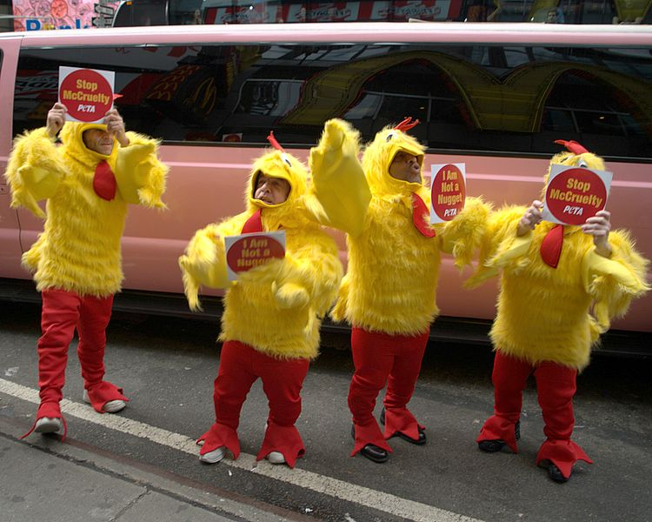
Altruism v. Psych. Egoism
Altruist’s reply: When a PETA activist stands in the hot sun in a chicken suit outside McDonald’s, they’re sacrificing for others (namely, chickens).
PE reply: No. The PETA activist stands in the sun to avoid feeling guilty about not helping the chickens.

Slide 18
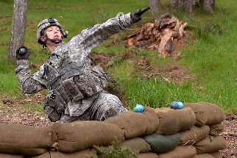
Altruism v. Psych. Egoism
Dutiful folk’s reply: When a soldier falls on a grenade to save buddies, he or she is plainly motivated by concern for others.
PE reply: No. The soldier knows he or she would feel terrible for not sacrificing for the others, and falls on the grenade to avoid a life of guilt.

Slide 19
Psychological Egoism
Criticism 1 of PE
Guilt seems to presuppose concern for others for their own sake. If it did not, why would we feel guilty for letting those others suffer (chickens), or for letting them die (comrades)?
If guilt presupposes concern for others, then concern for others is a motivating factor in human action, and PE is false.

Slide 20
Psychological Egoism
PE reply to Criticism 1
People only feel guilt due to training or conditioning. Therefore, any concern for others that produces guilt is artificial.
Does that reply work?
_________________

Slide 21
Psychological Egoism
Criticism 2 of PE
PE’s replies might fit some cases …
perhaps some soldiers jump on grenades to avoid dishonor
perhaps some activists skip the football game and picket KFC to avoid guilt
perhaps some religious figures do good to avoid eternal punishment
but why think those all soldiers, activist, religious folks are so motivated?
Psychological Egoism is a Hasty Generalization

Slide 22
Psychological Egoism
PE Reply to Criticism 2:
Standing Presumption should be on PE side.
We know we act selfishly very often.
We don’t know we ever act altruistically.
If any examples of altruism proposed are possibly selfish, that’s good evidence we are always acting selfishly, despite appearances.
The Burden of Proof falls on Altruism
Does that reply work? _______________

Slide 23
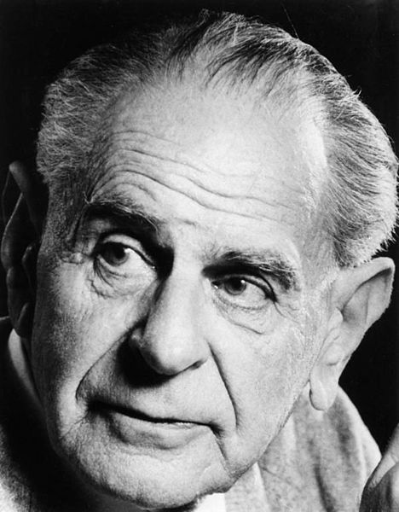
Psychological Egoism
Criticism 3 of PE
Karl Popper (1902-1994) suggested that a theory is meaningful only if some conceivable test could show it was false: Falsifiability is required of any “scientific theory”
Is PE a scientific theory? In the sense that it is a descriptive theory, and not a normative theory, yes (it makes a claim about how our minds work, not about how they should work).
Can PE be tested? Perhaps. Psychologists try to prove infants are hardwired for altruism. Those studies, though, are inconclusive to date … can they ever succeed?
Mengzi argues for this. See slide 6, or Koller, p211 top

Slide 24
Psychological Egoism
Desperation Reply of PE:
Look, we’re going around and around! Just think about it … those examples of altruistic behavior you like? They must be selfish deep down because, after all, the agent wanted to do those things. And if anything you do you must want to do, that’s egoism!

Slide 25
Psychological Egoism
Reply to Desperation Reply of PE:
No, no … that’s Trivial Egoism!
Of course, every action we choose to perform is an action we “want” to perform, but that only means perhaps 1% of a person’s motivation is self-interested. It is possible the other 99% of motivation is real concern for others (people, animals, … any non-self things).
What PE must hold to avoid the label “trivial,” is that ALL human acts are motivated ONE HUNDRED PERCENT by self-interest.

Slide 26
Psychological Egoism
Predominant Egoism?
If the psychological egoist
rejects the trivial version of PE, and
gives up proving motivation is 100% selfish
then PE has lost …
the alternative that follows from that admission, Predominant Egoism, is philosophically uninteresting
There is nothing surprising or enlightening about most motives being selfish
There are no interesting consequences for ethics

Slide 27
Psychological Egoism
Conclusion for PE:
If training or conditioning is responsible for other-regarding desires or concerns, does that immediately show PE is false, or is there something to the idea that such are artificial?
Does the mere existence of such other-regarding desires, who cares where they came from, invalidate PE?

Slide 28
Transition Slide
Xunzi is a Confucian. But as far as Koller tells us, he believes humans are born with selfish desires which, when they go unsatisfied, lead to conflict (Koller, p212). He needs a way to account for how the goodness Confucius describes can take root in or be applied to naturally selfish persons.
One way this has been attempted in the West is by a theory called Ethical Egoism. Let’s take a look:

Slide 29
Ethical Egoism
Ethical Egoism (EE) says every human act ought always to be directed toward self-interest.
First, a question…
If PE were true, would Ethical Egoism (EE) even be possible?
EE says we always ought to act selfishly, but if PE is true, we psychologically must act that way.
Does it make sense to say we have an obligation to act in a way we already must act? _______________

Slide 30
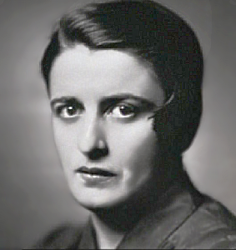
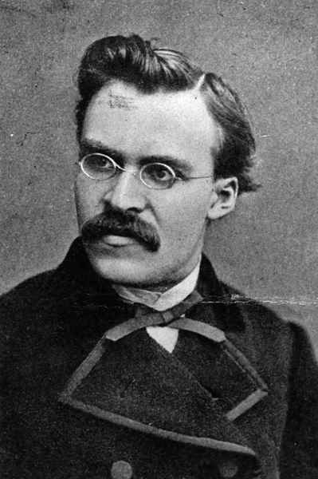
Ethical Egoism
4 Reasons to Accept Ethical Egoism, the view that every human action ought to be directed toward self-interest.
EE provides the strongest possible connection between acting morally and acting rationally.
EE, for Ayn Rand, Friedrich Nietzsche, others, focuses on the indignity of being subservient to others.
Acting for self-interest makes for a better world; altruism creates dependency.
EE does not really differ in content much from Standard Moral Theories (SMT)—Mill, Kant, Aristotle

Slide 31
Ethical Egoism
Reason 1: Strongest possible connection between acting morally and acting rationally?
Standard moral theories often have an uphill battle getting people to act on the theory’s principles as the principles are cast in terms of limiting freedom. For instance, generally:
Morality consists in striking the right balance between Duty and Interest. (Many Ethics texts are titled “Duty and Interest.”
It would be convenient if all duties were really in our interest due to a lack of obligation to be concerned about others.

Slide 32
Ethical Egoism
Reason 2: (SMT are insulting) skip
Reason 3: (altruism creates moochers) skip
Think about them yourself; do they make sense to you?
Are reasons 2 and 3 epistemic reasons (reasons to think EE is true), or practical reasons (reasons to accept it, live by it)?

Slide 33
Ethical Egoism
Reason 4 is defended with “The Cooperation Defense”
Being kind, generous, friendly, etc., leads to long-term “self benefits,” and so EE is basically the same as conventional morality or SMTs.
Ask yourself, on Ethical Egoist grounds,
What reason do I have to give to the homeless person at the stop light?
Why will I not cheat on my spouse?
Etc.

Slide 34
Human Nature is Bad Xunzi (cont.)
Would Xunzi accept Ethical Egoism? _____________
Here is Koller’s description of Xunzi’s view:
He [Xunzi] argues that because of their desire to live better, people use their intelligence to create forms of social organization and culture that regulate human behavior. People cannot provide the goods needed to live, let alone live well, except through the cooperation of other persons. Nor can people make themselves secure from the various creatures and forces of nature without mutual cooperation. (my italics)
How does social organization bring about goodness? Xunzi’s answer is that social organization requires rules of conduct, and following these rules brings about goodness.
… [W]hereas Confucius saw ren as primary and Mengzi saw yi as primary, Xunzi put the emphasis on li [propriety]. But all agreed that cultivation of moral virtue was the key to individual and social well-being. –Koller, p213

Slide 35
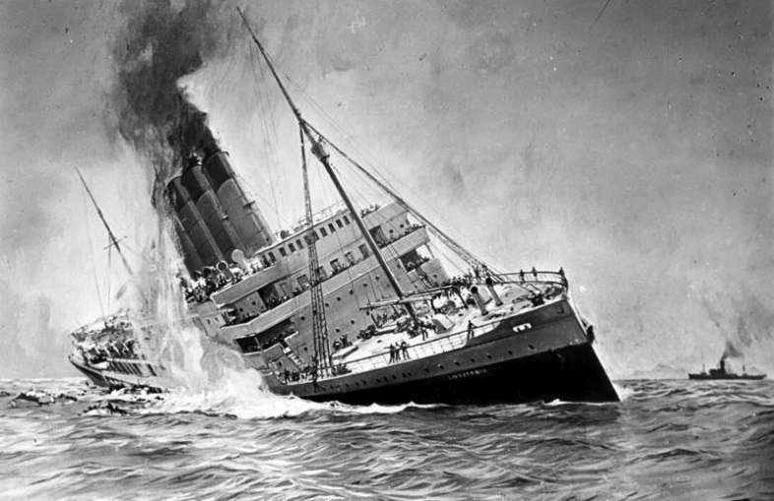
Criticism of Ethical Egoism
A failing of the cooperation defense?
You are rowing a boat to safety after your cruise ship sank and a desperate man a few yards off is calling for help. There are no other survivors, the man has no chance without you, and you have no interest in saving him. EE suggests you have no duty to save the man since any such duty would have to be grounded in your having a reason to act, and, as we’re supposing, you have no interest in saving the man.
Could Xunzi accept this view of ethical conduct and remain a Confucian? ______________

Slide 36
Criticism of Ethical Egoism
EE is often criticized for failing to support the common moral values of
friendship,
sensitivity, and
good-will
because of its view that we never ought to have concern for others for their own sake, but only ever as a means to our own pleasure or advantage.
Would this bother Xunzi, or is it rather his very opinion?

Slide 37
Human Nature is Bad Xunzi (cont.)
Koller’s final words on Xunzi:
From Mengzi was taken the emphasis on developing the goodness inherent in human nature and the emphasis on ensuring the correctness of action to the development of humanity.
From Xunzi was taken the emphasis on following rules of behavior for developing human nature and the use of laws and punishments for discouraging bad behavior. By adopting both views, Confucianism endorsed respect for internal sanctions, using internal feelings as guides to behavior, and for external sanctions, using social rules as guides to behavior. –Koller, p213
So, looking back at Ethical Egoism, and having read Koller’s account of Xunzi’s views (include p,209 in your assessment) …
Does Xunzi think we become good by following li, or is it merely our behavior that becomes good? _______________
Is Xunzi an Ethical Egoist? ___________

Slide 38
Dong Zhongshu and the Victory of Confucianism
Read Koller, pp214-215, for the history of how Confucianism finally won out over Realism and Mohism, being adopted by Emperor Wu of the Han Dynasty.
Note that the victory required compromise, employing Mengzi and Xunzi’s positions, and not only those, but ideas from “[D]aoism, Yinyang thinking, and even aspects of shamanistic practices….”

Slide 39
Images
All images are public domain images with no restrictions on use, from www.wikimedia.com

