Slide 1
Buddhism

Slide 2
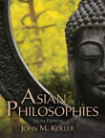
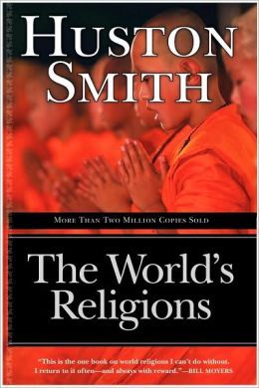
Sources
Asian Philosophies, 6th Edition, John M. Koller (hereafter “Koller”)
The World’s Religions, 50th Anniversary Edition, Huston Smith (hereafter “Smith”)
Read p82-119 in Smith, or, Read Ch.4 & 5, skim 6, in Koller

Slide 3
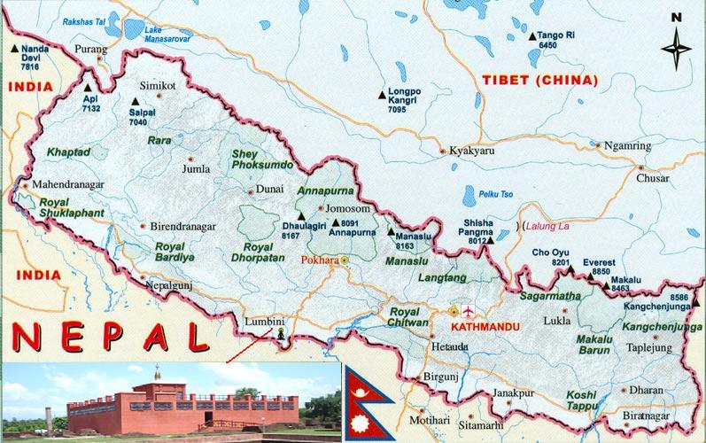
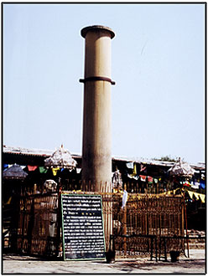
The Buddha’s Birthplace

Slide 4
Buddhism, Generally…
Siddhartha Gautama (563 BC - 483 BC) was born in ancient India (in tiny Lumbini which is now in Nepal, bordering India), a prince whose teachings resulted in the philosophy or religion of Buddhism.
A ‘Buddha’ is an enlightened person whose teachings reveal the nature and path of salvation …
Buddhists recognize Gautama as the supreme Buddha of our age
Buddhist literature identifies 6 Buddhas prior to Gautama.

Slide 5
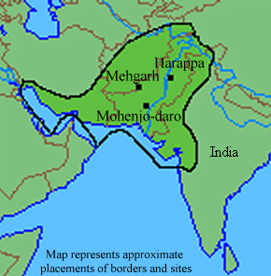
Buddhism, Generally…
Gautama presents his views as improvements on more ancient views common in the Indus Valley civilization he was born into.

Slide 6
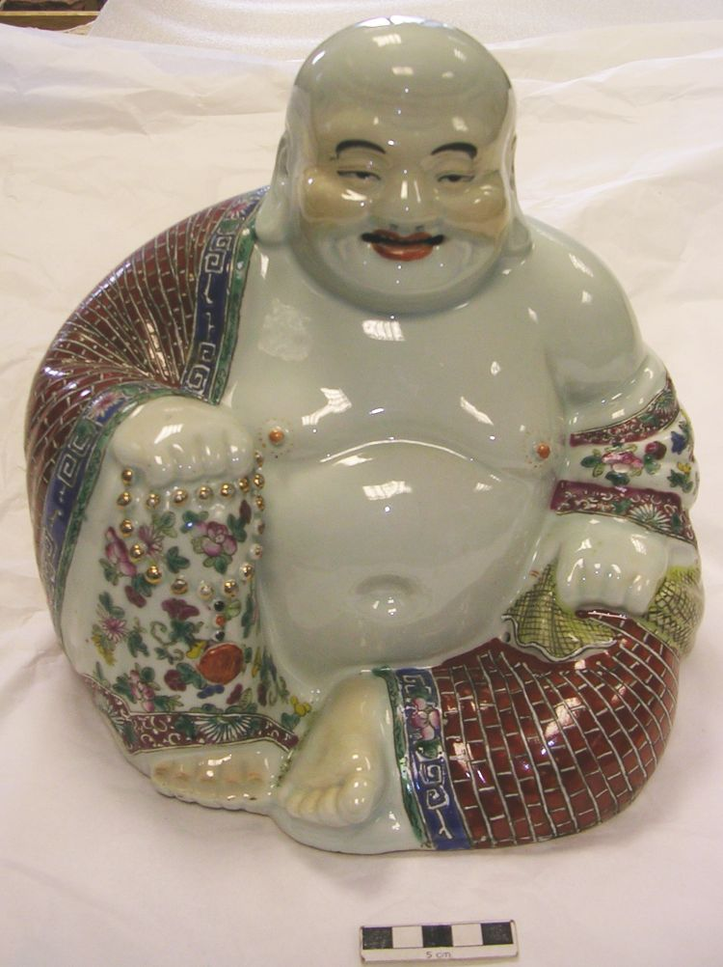
This is not The Buddha…
The image here is of Budai (Chinese), or Hotai (Japanese), a Buddhist monk who lived in China 1,500 years after Siddhartha.
Read about Budai on Wikipedia if you like.
Photo © The Hunterian Museum and Art Gallery, University of Glasgow 2013

Slide 7
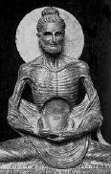
This, is the The Buddha…
The story of Gautama’s life leading up to his enlightenment ends with him leaving behind the ascetic life (which had reduced him to a skeleton) with the discovery of the wisdom of the “middle way.”
http://webspace.ship.edu/cgboer/siddhartha.html

Slide 8
The Tri-Laksana
Gautama presents 3 huge generalizations discovered through mediation. The three are called the “Tri-Laksana” -the three characteristics of existence:
Anicca: impermanence (everything changes)
Dukkha: unsatisfactoriness (everything sucks)
Anatta: impersonality (everyone is an illusion)
Annica: Ship of Theseus, Heraclitus’ River vs. Essentialism

Slide 9
Tri-Laksana Reasoning
Since
everything changes (Anicca),
nothing we desire can last (Dukkha),
even we ourselves can’t stay the same since we are composed of 5 things, none of which is permanent (Anatta)
Dukkha: Desire Satisfaction v. Eudaimonia

Slide 10
The Five Aggregates
The five components (called the Five Aggregates) of people are:
“Form” or “Matter” (the body)
“Feelings” or “Sensations”
“Perception,” “Cognition,” etc.
“Thought,” “Volition,” etc.
“Consciousness”
Anatta: Existentialism and
Bundle Theory of the Self vs. Transcendental Unity of Apperception

Slide 11
Achieving Enlightenment
Philosophical reflection on those 3 characteristics of existence
results in wisdom
result in release from Samsara
the cycle of birth, life, death, and rebirth
depending on how deeply we understand and appreciate those insights
Gautama’s way of explaining this is through …
The 4 Noble Truths, and
The Middle Way

Slide 12
The Four Noble Truths
1st Noble Truth: Suffering is universal
2nd Noble Truth: Desire causes suffering
3rd Noble Truth: Eliminate desire, eliminate suffering
4th Noble Truth: Follow Noble Eightfold Path, Eliminate desire

Slide 13
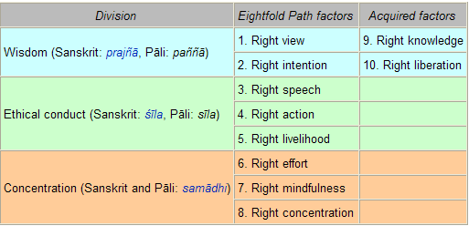
Buddhist Ethics
Noble Eightfold Path:
From: http://en.wikipedia.org/wiki/Noble_Eightfold_Path

Slide 14
Buddhist Ethics
Noble Eightfold Path:
Have the right understanding of life, the nature of the world, etc.
Have the right aspirations, goals.
From: http://en.wikipedia.org/wiki/Noble_Eightfold_Path

Slide 15
Buddhist Ethics
Noble Eightfold Path:
Abstain from lying, divisive speech, abusive speech, idle chatter, etc.
Abstain from killing, stealing, illicit sex.
Abstain from selling weapons, slaves, meat, intoxicants, poisons

Slide 16
Buddhist Ethics
Noble Eightfold Path:
Prevent, Destroy unwholesomeness; arouse, maintain wholesomeness
Be mindful, deliberate, not forgetful and inattentive
Concentrate until reaching meditative absorption; think really hard

Slide 17
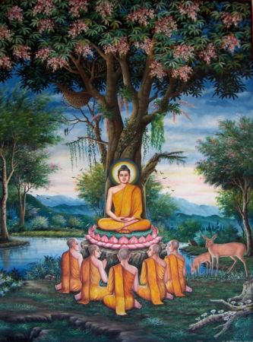
The Middle Way
In following the Noble Eightfold Path toward enlightenment , the condition that releases you from suffering, follow the Middle Way.
Gautama experienced the error of seeking enlightenment through asceticism (strict denial of pleasures).
The Middle Way seeks to acknowledge our existence in the world while maintaining our insubstantiality and the world’s illusory character.
http://www.logoi.com/pastimages/buddha.html

Slide 18
Reincarnation
What is reincarnated if there is no self or soul?
It appears simply your or my “stream of consciousness” continues,
supported by the law of Karma, and
the causal laws of the material universe.
Problems:
without a soul, what accounts for identity over time through change other than memory?
If you fail to remember a former life, how can it be your former life?

Slide 19
Reincarnation
Problems (repeated):
without a soul, what accounts for identity over time through change other than memory?
If you fail to remember a former life, how can it be your former life?
Possible answer to both:
As long as “your” stream of consciousness is causally conditioned by prior states (and, per Karma, previous lives’ accumulated merit and demerit affect present character), remembering those prior states is perhaps inessential for the self-as-bundle to endure.
2 Rikers on the Enterprise

Slide 20
Reincarnation
According to Smith, the Buddha’s position on reincarnation is that …
Ordinary people when they die leave strands of finite desire that can only be realized in other incarnations; in this sense at least these persons live on. But what about the Arhat, the holy one who has extinguished all such desires; does such a one continue to exist? –Smith, p117

Slide 21
Reincarnation
Siddhartha’s answer was...
Feelings, perceptions, forces, consciousness—everything by which the Arhat might be denoted has passed away for him. Profound, measureless, unfathomable, is the Arhat even as the mighty ocean; reborn does not apply to him nor not-reborn, nor any combination of such terms.
–Buddha (in Smith, p118)

Slide 22
Nirvana
Nirvana is the name of the goal for human beings.
Nirvana =df to extinguish, to blow out.
Do we cease to exist; is extinction nirvana?
No. The Buddha teaches that this extinction is the extinction of the finite or empirical self.
Consider Edward Conze’s compilation of Buddhist text attributions to nirvana (Smith, p115):
…Nirvana is permanent, stable, imperishable, immovable, ageless, deathless, unborn, and unbecome, … it is power, bliss, and happiness, the secure refuge, the shelter, and the place of unassailable safety; … it is the real Truth and the supreme Reality; … it is the Good, the supreme goal and the one and only consummation of our life, the eternal, hidden and incomprehensible Peace.
So, what does that sound like from Hinduism? ________________

Slide 23
Nirvana
Smith, p114, asks, “Is Nirvana God?”
He answers:
The Buddha did not consider it personal because personality requires definition, which nirvana excludes.
Smith quotes the Buddha as saying:
There is, O monks, an Unborn, neither become, nor created, nor formed. … Were there not, there would be no deliverance from the formed, the made, the compounded.
What does that sound like? ___________________
Oddly, Smith doesn’t consider the similarity, except to “mystical traditions.”

Slide 24
Early Division of Buddhism
Theravada
Mahayana
emancipation by human effort – no supernatural aid
Key: wisdom
attainment requires monk-like devotion
Ideal: Arhat, who remains in nirvana after death
Buddha: a supreme teacher, role model
Minimizes ritual & metaphysics
Practice centers on meditation
emancipation aided by divine powers
Key: compassion
Religious practice available to everyone
Ideal: Bodhisattva
Buddha: a savior
Elaborates metaphysics
Emphasizes ritual
Includes petitionary prayer
from Smith, p126

Slide 25
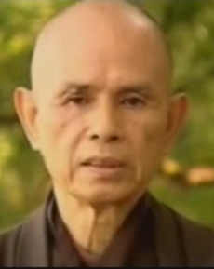
More Divisions
Buddhism
Mahayana
Zen (Japan)
Ch’an (China)
Theravada
Theravada
Ti’en Tai (China)
Tendai (Japan)
Pure Land Sect
Thich Nhat Hahn … Vietnamese Buddhist Monk, Zen tradition
Click image for youTube video

